Slide 1
Content Automation & Transformation(CAT) Framework
Ben Wang
April 2017

Slide 2



Challenges in Content Data Transformation (1) – Heavy Development Work
Content data sets come from the manual / auto information inputs by content analysts, and are transformed into the formats for feeds and Eikon, including join, filter, picker, normalization, and so on.
There are many challenges to implement such transformation:
Every data set needs a lot of development and test works. The normal time to market for each set is 6 months or even longer
Many similar works are duplicated among the data sets with different implementations
It is very difficult to make the transform scalable to support TB level data sets

Slide 3
Challenges in Content Data Transformation (2) – Hierarchical Data
Many content data sets are hierarchical, such as JSON and XML, transformed from unstructured data such as PDF reports, news, deals, and so on.
Hierarchical data has many advantages than flat data (such as table), including flexibility, extendibility, self-contained, storage efficiency, and so on.
However, it is much harder to transform between hierarchical data than flat data
For batch processing, SQL can handle the transformation of flat data well. But the solutions for hierarchical data are not mature enough yet, including JSONiq, SQL++, …
For streaming updates, even SQL does not fully support it on flat data, such as Flink and Calcite. It is much more difficult to support if on hierarchical data.

Slide 4
CAT : Solution for Hierarchical Data Transformation
CAT system provides the reference solution of hierarchical data for the data sets transformation
CAT acts as the key solution for EDS
Now the current customers include TRF, Search, and Deals
Basic idea:
Rebalance between the transform functions and streaming update by only support a sub-set of SQL operations
Support streaming update with internal algorithms instead of SQL technologies
Key features
Join function with filter, picker, and customized formatter and writer
Support streaming updates based on new inputs
Auto type extraction
Data normalization and binary store
Define transformation with the rules
Technologies: Hbase, ElasticSearch, Spark, Yarn, ZooKeeper, Arvo, …

Slide 5
EDS – Interactions with Sources (ECP, ERT, Open Platform)
CAT

Slide 6
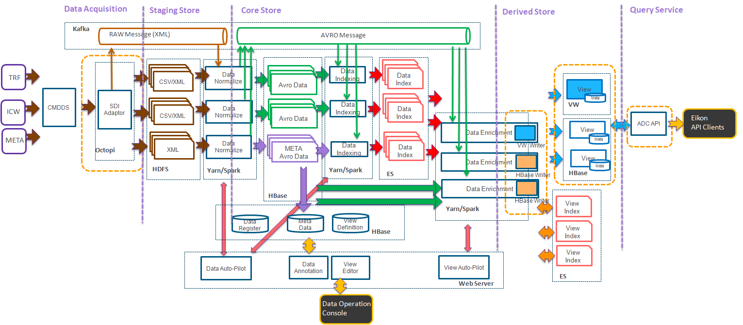
CAT and TRF Architecture

Slide 7

Binary Store
Binary Meta Data
Hierarchy
Data Type
Annotation
Primary Key
Data Type
Binary Data
Data Element
Compacted
Strong Typed
Raw Data
Weak Type
Hierarchy
Data Element
Binary Store
HBase
Avro Data Serialize/Deserialize
Key from annotation
Purpose
Convert structured, semi-structured data into structured data
Generate meta data from accumulated raw data
Store data into HBase for easy random access
Generate strong typed data by annotation

Slide 8
Data Enrichment
Purpose
Predefined view
Save the resource and time when interactive query
Avoid query time join – Aggregation is allowed
Binary Data
Mount #2
Mount #1
PK/FK
Data Source #3
PK/FK
Data Source #2
Data Source #3

Slide 9
Data Enrichment
Document Join
Mount #2
Mount #1
PK/FK
PK/FK
Derived View

Slide 10
Data Enrichment
√
Post-Join Process
Filter
Choose the whole record when it matches a criteria
Picker
Find out which field will be present in the target document
We are using white list here
Formatter
Re-organize the document hierarchy
For some specific use cases in derived store
Derived View
Notes:
## Filter There are three types of *filtering*: 1. `record filter`: The Avro record itself is picked or discarded. Only one string. 2. `array filters`: Select array elements meeting certain criteria and discard others. 3. `pickers`: Pick certain nodes in record tree and prune others. Note that `array filters` will be applied before `pickers`, meaning the nodes presented in former one can be absent in latter one. Refer to `README` in `rts-lib-avro_store_source` for usage example. ### Record filter Record filter: `(.a.effectiveTo == null || .a.effectiveTo >= 1400172800000)`. Records: // R1 { "a": { "effectiveFrom": 1000172800000 } } // R2 { "a": { "effectiveFrom": 1000172800000, "effectiveTo": 1200172800000 } } // R3 { "a": { "effectiveFrom": 1000172800000, "effectiveTo": 1400172800000 } } After filter, only records R1 and R3 will be kept. ### Array filter Array filter: `.Name{.TypeCode == "SHT"}` Record: { "Name": [ { "TypeCode": "SHT", "Text": "A" }, { "TypeCode": "SHT", "Text": "B" }, { "TypeCode": "L", "Text": "ABCD" } ] } After filter, record will be: { "Name": [ { "TypeCode": "SHT", "Text": "A" }, { "TypeCode": "SHT", "Text": "B" } ] } ### Picker Picker: `.Name.Nick`, `.Gender`. Record: { "Name": { "Nick": "Ned", "First": "Eddard" }, "Gender": "M", "House": "Stark" } After picker, record will be: { "Name": { "Nick": "Ned" }, "Gender": "M" }

